Slide 1


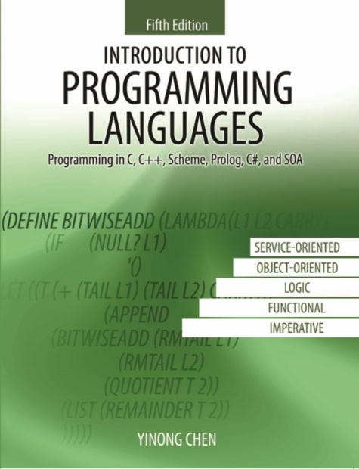
CSE240
Introduction to Programming Languages
Chapter 3
Object-Oriented Language C++

Slide 2
CSE240
Introduction to Programming Languages
Chapter 3
Object-Oriented Language C++
Lecture 15
Object Orientation and Class Definition
Reading: Textbook Sections 3.1 and 3.2
Dr. Yinong Chen

Slide 3
Chapter Outline
Principles and features of object orientation
Class composition and definition
information hiding: public, protected and private
Scope Resolution Operator
Queue class example and time class example
Memory management (static, stack, and heap) and garbage collection
Constructor, destructor, and overloading
Inheritance and multiple inheritance
Derived PriQueue class from a Queue class
Hierarchy and polymorphism
Publication and Personnel examples
When to use inheritance and when not to?
Exception handling
Summary

Slide 4
Class Organization
C++ focus on the multiple classes and their relationship.
If you do not write any class, it is mostly C.
Inside each class, it is similar to C program.
main() { …}
Class
0
Class containment
Class j
Class inheritance
Class inheritance
Class inheritance
Class 1
Class 2
Class n
Class k
Class containment
Class containment
Class i

Slide 5
Key Concepts in Object Orientation
Data and structure (Object) are the focus: Operations are part of an object for manipulating the data;
Abstract data type (class): Encapsulation of state in an object that can only be accessed through operations defined on them. Clean interface -- public and private components.
Inheritance: extends a class by keeping the unchanged parts as in original and allowing objects to use functions from ancestor classes. Supports code reuse.
Classes are organized in hierarchies.
Dynamic memory allocation and de-allocation
Dynamic binding
Polymorphism
Level of Abstraction
Java
C++
C

Slide 6
Class Definition
Class definition gives class members:
Description of state (internal variables) // struct
Operations (functions) // struct doesn’t allow functions
Example
class Queue {
private:
int queue_size;
protected: // for family members
int *buffer;
int front;
int rear;
public:
void enqueue(int v) {...}
int dequeue(void){... }
}
Use the class to declare
Queue q1(5), *q2;
q2 = new Queue(5);
// Access to Object
q1.enqueue(2);
q1.enqueue(8);
q2->enqueue (25);
x = q2->dequeue();

Slide 7
Implementation of Member Functions
In Java, implementations of methods are always in the class definition.
In C++, implementations of member functions can be in the class definition (for short functions) or outside of the class definition.
in-class: It could be more convenient to have function implementations in the class;
out-class: structurally clearer to separate implementation from definition;
Java argument: to have all related information in one place.

Slide 8
Queue and Queue Operations
front
rear
Initial
queue
. . .
0
1
2
3
4
5
6
7
queue_size - 1
dequeue
front
rear
enqueue
After
6 enqueues
2 dequeues
. . .
0
1
2
3
4
5
6
7
queue_size - 1
front
rear
Is the queue full?
. . .
0
1
2
3
4
5
6
7
queue_size - 1

Slide 9
Circular (Cyclic) Queue
n-1
0
n-1
0
n-2
1
1
n-2
2
2
front
rear
front
rear
entries = 0
For each queue-operation, it may take slightly longer time.
There is no penalty when the queue is falsely full.

Slide 10
Place a member function in the class
class Queue {
private:
int queue_size;
protected:
int *buffer; int front; int rear;
public:
void enqueue(int v) { // add an element
if (rear < queue_size)
buffer[rear++] = v;
else
if (compact())
buffer[rear++] = v;
}
bool compact(void); // implementation outside class
};

Slide 11
Scope Resolution Operator
Scope Resolution Operator
type class_name::function_name
If implementation of member functions are separated from class, SRO is used.
class Queue {
private: ...
protected: ...
public:
...
bool compact(void); // implementation
// outside class
};
...
bool Queue::compact(void) { ... implementation ... }

Slide 12
Scope Resolution Operator (Example)
bool Queue::compact(void) { // using SRO
if (front == 0) {
cout<<"Error: Queue overflow"<<endl;
return false;
}
else {
for (int i=0; i<rear-front; i++)
buffer[i] = buffer[i+front];
rear = rear - front;
front = 0;
return true;
}
}

Slide 13
Another Example: Time Class,
#include <iostream>
using namespace std;
class Time {
public:
Time(); // constructor
void setTime( int, int ); // set hour, minute
void printMilitary(); // print military time format
void printStandard(); // print standard time format
private:
int hour; // 0 - 23
int minute; // 0 - 59
};

Slide 14
Time::Time() { hour = minute = 0; } // constructor: initialize
void Time::setTime( int h, int m ) { // Set a new mil Time
hour = ( h >= 0 && h < 24 ) ? h : 0;
minute = ( m >= 0 && m < 60 ) ? m : 0;
}
void Time::printMilitary() { // Print time in military format
cout << ( hour < 10 ? "0" : "" ) << hour << ":"
<< ( minute < 10 ? "0" : "" ) << minute; // add "0"
}
void Time::printStandard() { // Print in standard format
cout << ( ( hour == 0 || hour == 12 ) ? 12 : hour % 12 )
<< ":" << ( minute < 10 ? "0" : "" ) << minute
<< ( hour < 12 ? " AM" : " PM" ) << endl;
}

Slide 15
Example: Time Class: the Main function
void main() {
Time t; // instantiate object t of class Time
cout << "The initial military time is ";
t.printMilitary();
cout << "\nThe initial standard time is ";
t.printStandard();
t.setTime(15, 27);
cout << "\n\nMilitary time after setTime is ";
t.printMilitary();
cout << "\nStandard time after setTime is ";
t.printStandard();
}
Time *p;
p = new Time();
// ~destructor?
// Do we need a destructor? When will it be called?

Slide 16
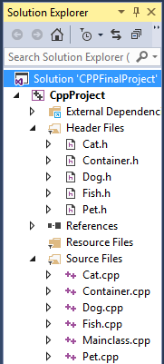
Each class is divided into a Header file and a Source file Example: Text Section 3.8
Header file: Class definition
Source file: Function implementations
Scope Resolution Operator:
Link them together
Pet
Inheritance hierarchy
name
breed
type
display()
inheritance
Cat
Dog
Fish
name
name
name
breed
breed
breed
head
type
type
type
display()
display()
temperature
display()
Container
*pet
*pet
*pet
…
*pet
*next
*next
*next
NULL
Dog
Cat
Dog
Fish
name
name
name
name
breed
breed
breed
breed
type
type
type
type
display()
display()
display()
temperature
display()

Slide 17
Memory Management in Languages
Operating system memory management: allocates a piece of memory to each task (program).
The memory allocated to a program is divided into three areas:
Static memory
Stack
Heap
The programmer can choose where to obtain memory. In both C and C++:
All global variables (variables outside any classes or functions) AND all static local variables in classes or functions obtain memory from static memory.
All non static local variables in functions (incl. global and member functions) obtain memory from the stack.
All dynamically allocated variables (using malloc and new) obtain memory from the heap.

Slide 18
Partition of Memory Allocated to a Program
OS allocates the memory block (starting address + block size)
Starting address
size known at compilation time
Program code
Static memory
Global and static variables & objects
size known at compilation time
Heap pointer
Heap
Variables and objects created using "new" or "malloc", including member functions
all local variables and local objects, including member functions
Stack pointer
Stack

